Slide 1

SQL
(STRUCTURED QUERY LANGUAGE)
Product Inventory Tracker
UNDER THE GUIDENCE OF:
PROF. JAFFRIN
BESANT TECHNOLOGIES
PRESENTED BY: MOHAMED TARIQ S

Slide 2
SQL
What is SQL
Uses of SQL
Why SQL is used
SQL (Structured Query Language) is a programming language designed for managing and interacting with relational databases. It allows users to query, manipulate, and control data in a structured and standardized manner.
Data Querying
Data Modification
Data Definition
Data Control
Data Integrity
Data Transactions
Data Aggregation and Reporting
Stored Procedures and Functions
SQL is used to manage and interact with relational databases, enabling tasks such as data retrieval, modification, definition, access control, data integrity maintenance, transaction management, and report generation. It is a fundamental language in database management and is widely used in software development and data analysis.

Slide 3
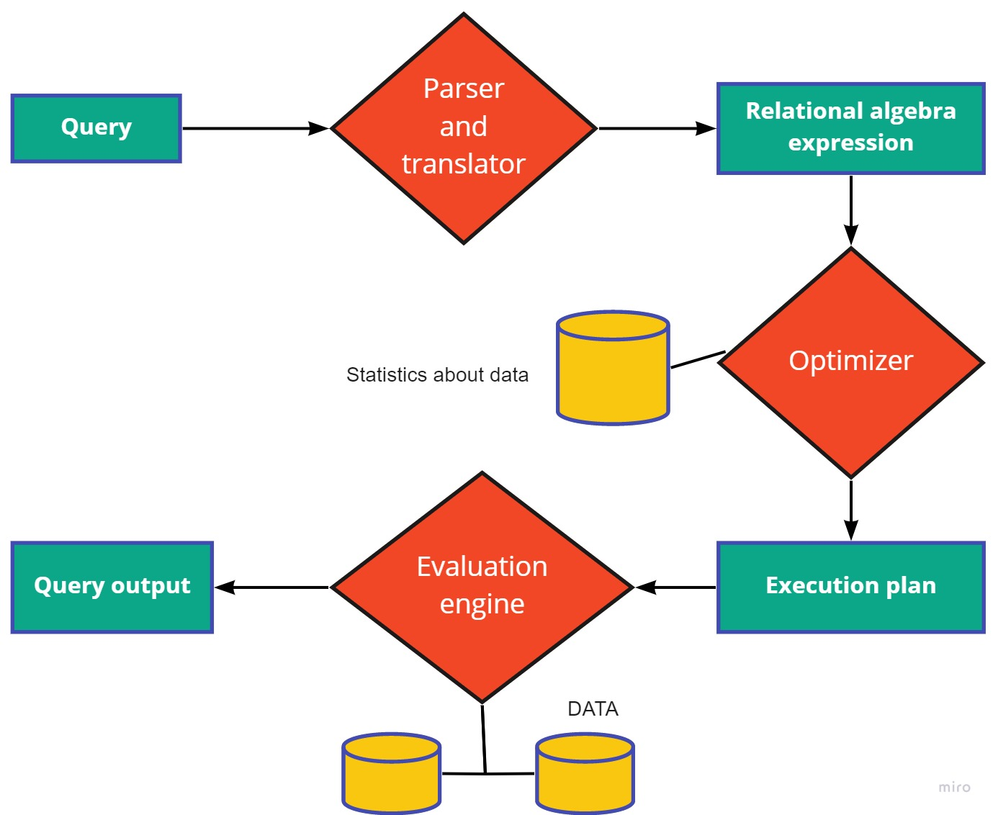
What is Query:
A query in databases, particularly in SQL, is a concise command for interacting with data. It's a specific request to retrieve, modify, or manage information stored in a database. Queries are crucial for tasks like data analysis, reporting, and maintaining database integrity.

Slide 4

Why is SQL crucial for websites?
SQL is crucial for websites because it enables efficient data management. SQL databases, like MySQL or PostgreSQL, store and retrieve data, allowing websites to dynamically generate content, manage user authentication, process e-commerce transactions, and ensure data integrity. SQL supports scalable solutions, essential for growing websites, and facilitates powerful search functionality, analytics, and reporting. It serves as a robust foundation for various web applications, contributing to their functionality, security, and effective handling of user interactions and data.

Slide 5

Product Inventory Tracker

Slide 6
Introduction to Product Inventory Tracker:
Welcome to the Product Inventory Tracker, a comprehensive database designed to streamline and manage product-related data efficiently. This system facilitates the organization and monitoring of products, their associated details, and the employees responsible for handling them. By leveraging the power of SQL, the Product Inventory Tracker ensures seamless tracking, reporting, and analysis of inventory-related activities, contributing to enhanced operational efficiency.
The Product Inventory Tracker is a sophisticated SQL-based solution designed to efficiently manage and monitor product-related information. This system empowers organizations to track products, their deliveries, and associated employee details seamlessly. Explore insightful queries for real-time reporting and analysis, ensuring optimal control over your product inventory.

Slide 7
Entity Relationship Diagram
Employers Table
(s_no INT auto_increment primary key
ename varchar(40)
designation varchar(40)
location varchar(40)
Gender enum('Male','Female’)
Emp_id int unique
phn_num int unique
salary int
department varchar(50)
Join_Date date)
Products Table
prd_id INT
prd_name VARCHAR(40)
emp_id INT
FOREIGN KEY (emp_id) REFERENCES Employers(Emp_id)
Delivery_loc VARCHAR(40)
delivery_date DATE

Slide 8
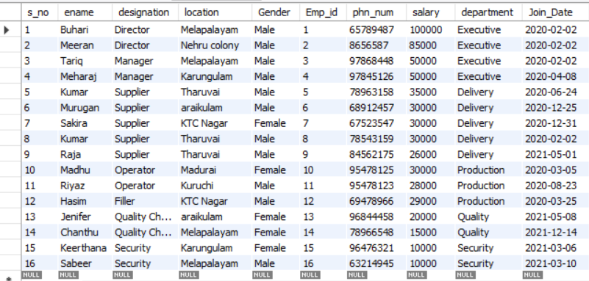
Employers Table:

Slide 9
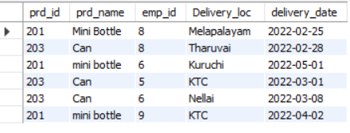
Products Table:

Slide 10
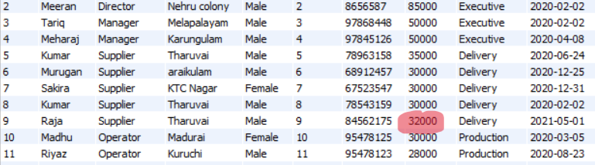
1. Query to Update value in the Table
UPDATE Employers SET salary = 32000 WHERE Emp_id = 009;

Slide 11
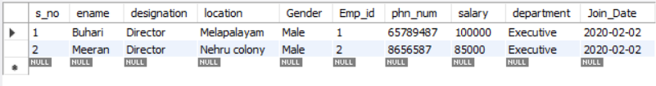
2.Query to view the employees who are receiving a salary greater than 50000
SELECT * FROM Employers WHERE salary > 50000;

Slide 12

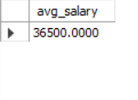
3.Query to view the sum and Average of the salary as the total salary and avg salary
SELECT SUM(salary) AS total_salary FROM Employers; SELECT AVG(salary) AS avg_salary FROM Employers;

Slide 13
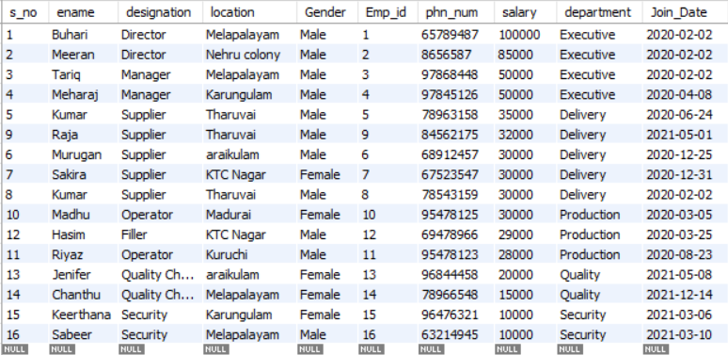
4.Query Using the function Order by :
SELECT * FROM Employers ORDER BY salary DESC;

Slide 14
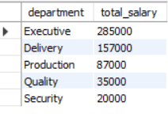
5.Query Using the Function Group by:
SELECT department, SUM(salary) AS total_salary FROM Employers GROUP BY department;

Slide 15
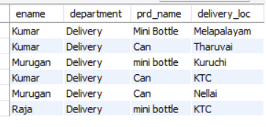
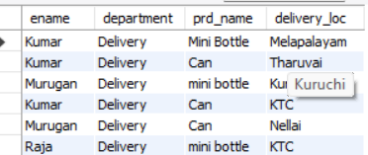
6.Query using the Function Join:
INNER JOIN:
SELECT e.ename, e.department, p.prd_name, p.delivery_loc FROM Employers e INNER JOIN Products p ON e.Emp_id = p.emp_id;
Right Join:
SELECT e.ename, e.department, p.prd_name, p.delivery_loc FROM Employers e RIGHT JOIN Products p ON e.Emp_id = p.emp_id;

Slide 16
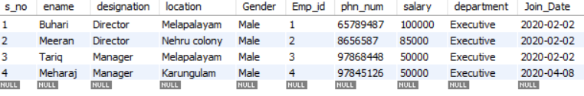
7.Using Sub-Query:
SELECT * FROM Employers WHERE salary > (SELECT AVG(salary) FROM Employers);

Slide 17
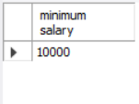

8.Query to find Minimum and Maximum Salary:
SELECT min(salary) as 'minimum salary' from employers; Select max(salary) as 'maximum salary' from employers;

Slide 18
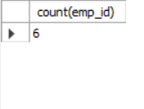
9.Query to Count the Values in a particular Column:
select count(emp_id) from products;

Slide 19
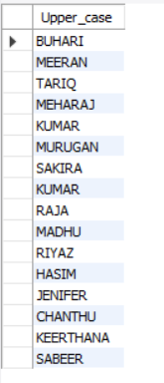
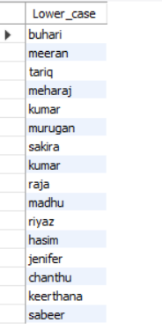
10.Query To View The String Values In Upper And Lower Case:
select ucase(ename) as Upper_case from employers;
select Lcase(ename) as Lower_case from employers;

Slide 20
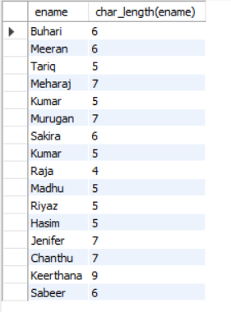
11. Query to find the Character Length:
select ename, char_length(ename) from employers;

Slide 21
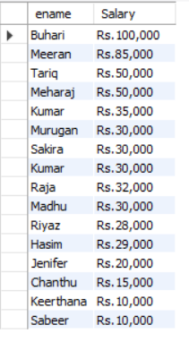
12. Concat and Format:
select ename, concat('Rs.',format(salary,0)) as Salary from employers;

Slide 22
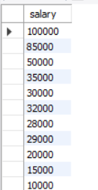
13. Query using the Function Having:
select salary from employers group by salary having max(salary) >= 10000;

Slide 23
Conclusion:
The Product Inventory Tracker, driven by SQL, revolutionizes product and employee management.
Our database structure ensures seamless data organization and retrieval.
SQL queries empower real-time insights, reporting, and informed decision-making.
Benefits include heightened operational efficiency and a data-driven approach to inventory management.
As we advance, we anticipate continuous improvement and scalability.
Thank you for exploring the Product Inventory Tracker

Slide 24


